Slide 1
Housing-Price Prediction Project

Slide 2
Exploratory Data Analysis

Slide 3
Steps
Importing the libraries needed for my project
Loading the dataset/Creating my dataframe
Checking the head of the dataset(first five rows)
Checking the shape of the dataset
Checking the datatypes
Checking for null values if any
These data analysis steps help us to get an overview of our dataset and also help us in our preprocessing of our data.

Slide 4
Preprocessing of the data

Slide 5
Steps and Description
I have dropped the column ‘ Id’ as it is of no use, it is only giving some numbers.
Then I have checked the shape and datatypes of the train dataset.
Again I have dropped some columns which are not efficient.
I have checked the value counts of the necessary columns and also checked if any null values are present.
I have used Label Encoder to encode the object type columns and used mean to replace the null values.
I have done some visualizations using heatmap,barplots,cat-plot and scatter-plots.
I have checked the correlation between dependant and independent variables using heatmap.
I have splitted the dependant and independent variables into x and y.
I have scaled the data using StandardScaler method and made my data ready for model building.

Slide 6
Observation
From the train dataset, it is seen that there are some columns which are highly correlated with the target variable ‘SalePrice’.
So I think those columns which are not correlated with the target variable will not give any fruitful result.
That’s why I have dropped those columns from the dataset.
Also I have observed that there are null values in most of the columns, so I have checked null values for almost each and every column and replace them with mean.
There are also some object type columns present in the dataset, I have observed it when I have checked the datatypes.

Slide 7
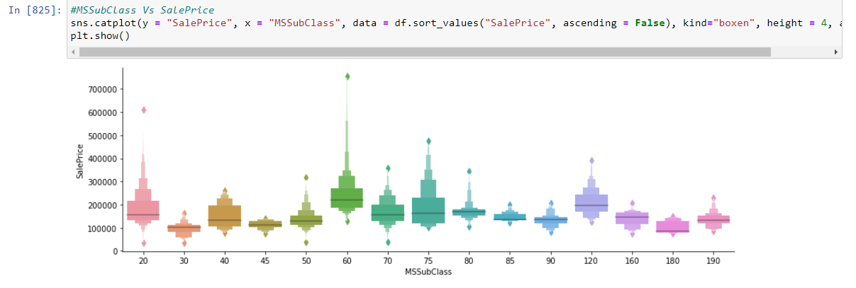
Some more preprocessing steps
Some visualization is done using bar-plots, cat-plot and scatter-plots where we can see the relation of our input variables with the target variable. I have attached some of the screenshots.

Slide 8
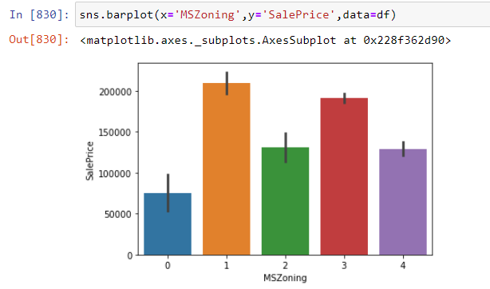
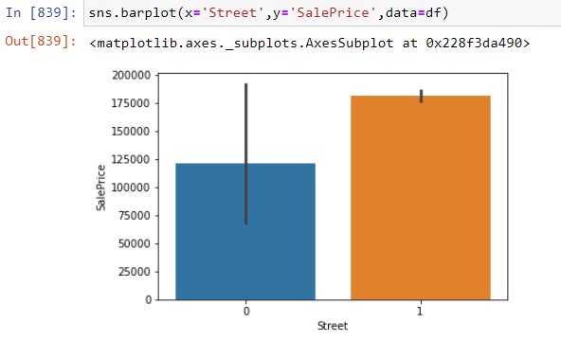

Slide 9
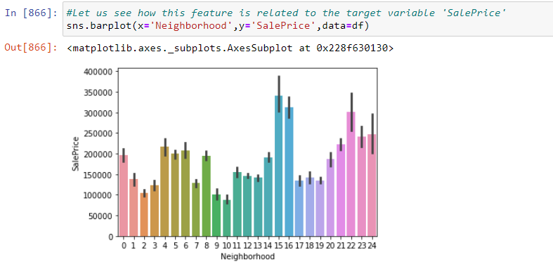
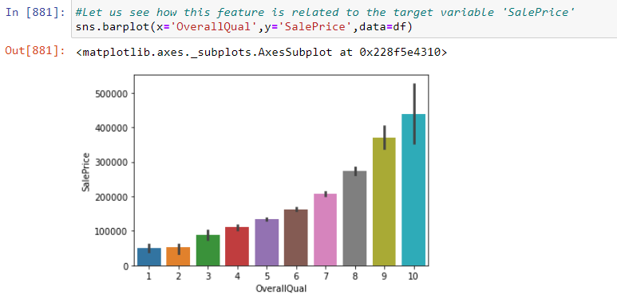

Slide 10
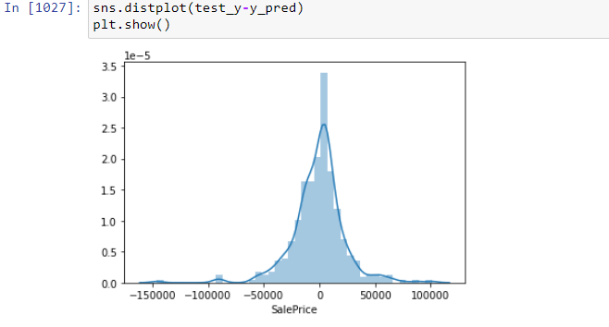
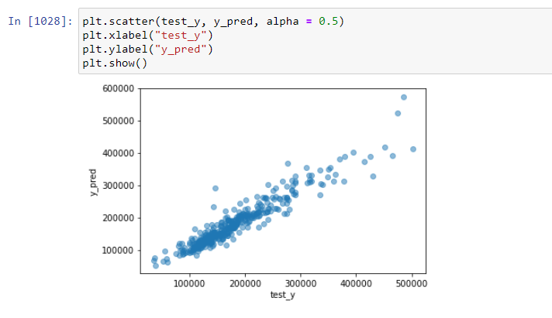

Slide 11
Preprocessing (contd…)
At the end of the preprocessing, I have again checked if any null values are present in any columns.
I have found null values in a column ‘GarageYrBlt’ again , then the null values are replaced using mean.
Then scaling the data to a standard form using StandardScaler
Now my train dataset is cleaned completely and is ready for model building.
The same preprocessing steps are followed for the test dataset as I have done with my train dataset.

Slide 12
Model building

Slide 13
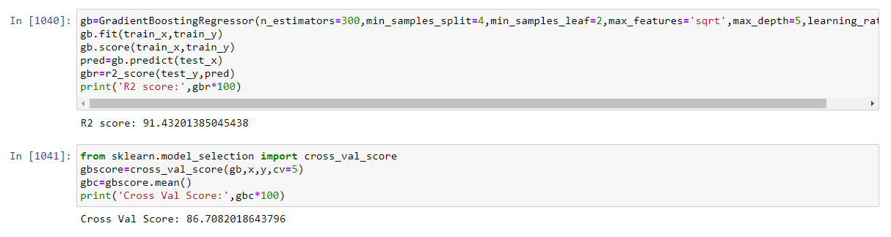
Explanation
I have used six algorithms for testing, out of which Gradient Boosting Regressor gives a good accuracy score. So, I have selected this algorithm for my project. The cross validation score for the model is 87% which was further increased using hyperparameter tuning (RandomizedSearchCV).The accuracy score that is obtained finally is 91%.

Slide 14
For the test dataset:
I have created the dataframe for the test dataset and follow all the cleaning steps as I have done in the train dataset.
I have trained my model on my train dataset and predict on my test dataset.

